Slide 1


An Autonomous Institute
Affiliated to VTU, Belagavi,
Approved by AICTE, New Delhi,
Recognized by UGC with 2(f) & 12(B)
Accredited by NBA & NAAC
DEPARTMENT OF COMPUTER SCIENCE AND ENGINEERING
SUBJECT CODE : 17CSP78
SUBJECT NAME: Project Work Phase–I
1st LEVEL PROJECT REVIEW ON “Debility in Plants and Fruit Quality Detection ”
Under the guidance of,
Vidyashree DM,
Assistant Prof, Dept. of CSE, MVJCE
Presented By,
Kola Ganesh 1MJ17CS078
Kundan Kumar 1MJ17CS084
Kavindra Yadav 1MJ17CS181
An Autonomous Institution ,Affiliated to Visvesvaraya Technological University, Belagavi. Approved By AICTE, New Delhi. Recognized by UGC with 2(f) & 12(B) status. Accredited by NBA and NAAC.

Slide 2
Introduction
Agriculture has much more importance than simply a means to nourish ever growing populations.
They make important nutritional contribution to human well-being because of their high nutritive value.
Due to the plant diseases there are major economic losses in agriculture and forestry.
It is need to ensure the quality of fruits that are consumed at very places.
Therefore, early detection and identification of plant diseases plays the utmost important role to take timely measures.
To do this, a fruit and plant disease detection system can be established that can recognize various types of fruits and plant leaves from images.
The development of computer vision models offers a quick,standardised and accurate solution to this issue.
The convolution neural network is used for classifying the diseases in plants and also as fruit detection system.

Slide 3
Aim & Objective
To develop a high-performance fruit quality and plant leaf diseases detection system that can be quickly trained with a small number of images using a convolutional neural networks .
This system would help us to study the performance of the convolutional neural networks for detecting objects of images.
To improve the detection quality using deep convolutional neural networks compared to support vector machine.
An ideal fruit and leaf disease detection system is accurate, can be trained on obtainable data sets, produces its predictions in real time, adapts to different types of various fruits and works using different modalities, such as infrared images and color images.
The aim of this project is to develop a user friendly system for the farmers that will help farmers in finding out diseases of plant and detect the quality of fruits without bringing an expert to the field.

Slide 4
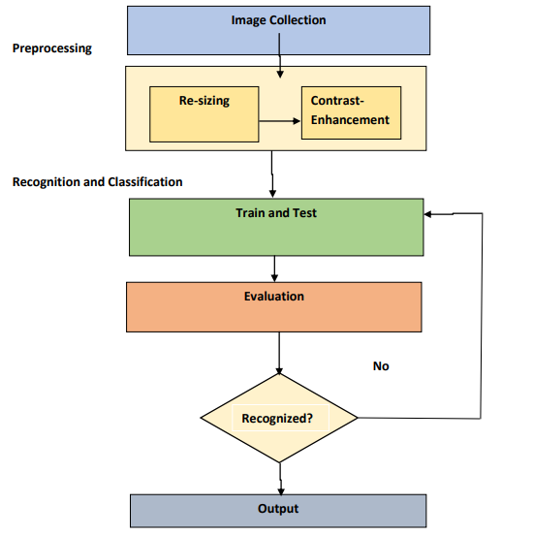
Block Diagram
Fig 1:- Block Diagram of system

Slide 5
A block diagram is a short road map which graphically represents how the data moves through the system.
The block diagram shown in figure 1 is used in design process.
The block diagram provides facilitating communication between us and user.
It shows the input and output information i.e. what kinds of information will be input to and output from the system, where the data will come from and go to, and where the data will be stored.
However it does not show information about the timing of processes but shows the work procedure of the processes.

Slide 6
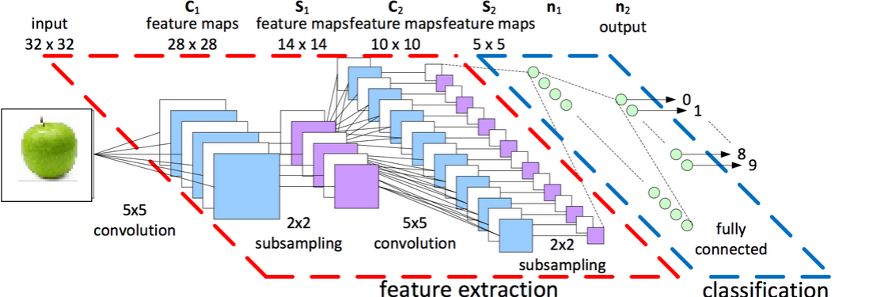
Architecture
Fig 2:- Convolutional Neural Networks architecture

Slide 7
Architecture
Feature Extraction
In feature extraction part, the network will perform a series of convolutions and pooling operations during which the features are detected.
Classification
In the case of classification, the fully connected layers will serve as a classifier on top of these extracted features. Here, they will assign a probability for the object on the image being what the algorithm predicts it is.
Fully Connected Layer (FC Layer) of Classification
Adding a Fully-Connected layer is a cheap way of learning non-linear combinations of the high-level features as represented by the output of the convolutional layer.

Slide 8
Why CNN and not SVM ?
Support Vector Machine (SVM)
Support Vector Machine (SVM) can be used for both regression and classification tasks.
But, it is widely used in classification objectives.
However SVM algorithm has several key parameters that need to be set correctly to achieve the best classification results for any given problem.
It is effective in that cases where number of dimensions is greater than the number of samples.
But this algorithm is not suitable for large data sets. Because it needs much time for training.
It does not perform very well, when the data set has more noise.
So SVM is not worked very well for data prediction.

Slide 9
Why CNN and not SVM ?
Convolutional Neural Network(CNN)
CNN (Convolutional Neural Network) algorithm is more powerful algorithm for classifications.
CNN involves various classes for classifications compared to SVM where classification results are also so good.
Besides CNN minimizes the hyper parameters used in the algorithm.
As a result it needs not much time for training. The training and testing accuracy of CNN is very high compared to SVM method.
That means it is relatively simple, quick to train, and easy to understand.
So we have decided to use Convolutional Neural Network and not Support Vector Machine.

Slide 10
Scope of Project
Scope is for working on development of innovative, efficient and fast interpreting algorithms which will help in detecting diseases in plants and would also help in detecting quality of fruits.
The proposed system is a software solution for automatic detection and computation of texture statistics for plant leaf diseases.
Identification of plants leaves and fruit quality and finding out the disease which play a key role in successful cultivation of plants.
To prevent diseases on plants and to inspect the quality of fruits.

Slide 11
Conclusion
The main approach of this system is to recognize the diseases and setect quality of fruit on different plant in agriculture environment where Speed and accuracy are the main characteristics of disease detection.
After reviewing all above mentioned techniques and methods we can conclude that there are number of ways by which we can detect disease of plants. Each has some advantages as well as limitations.
Plant diseases detection and fruit quality detection using CNN is best technique which gives fast and accurate result of plant diseases and fruit quality.
To prevent losses, small holder farmers are dependent on a timely and accurate crop disease diagnosis. A a pre-trained Convolutional Neural Network is free, easy to use.
Overall, this demonstrates how CNNs may be applied to empower small-holder farmers in their fight against plant disease and fruit quality detection.

Slide 12
Conclusion
In this work, specialized deep learning models are developed,based on speciﬁc convolutional neural networks architectures, for the identiﬁcation of plant diseases and fruit quality detection through simple leaves images of healthy or diseased plants and by using common fruits.
The training of the models will be performed using an openly available database of 87,848 photographs, taken in both laboratory conditions and real conditions in cultivation ﬁelds.
Based on that high level of performance,it becomes evident that convolutional neural networks are highly suitable for the automated detection and diagnosis of plant diseases through the analysis of simple leaves images.

Slide 13
References
C. Szegedy, W. Liu, Y. Jia et al., “Going deeper with convolutions,” in Proceedings of 2015 IEEE Conference on Computer Vision and Pattern Recognition (CVPR), pp. 1–9, 2015.
K. He, X. Zhang, S. Ren, and J. Sun, “Deep residual learning for image recognition,” in Proceedings of 2016 IEEE Conference on Computer Vision and Pattern Recognition (CVPR), pp. 770–778, 2016.

